Slide 1
See quiz at humanaiclass.org
Visualization for human-ai interaction

Slide 2
Assignment #1 review: whoa!
from sklearn.neural_network import MLPClassifier ???
from sklearn.ensemble import RandomForestClassifier
from sklearn import tree
clf = tree.DecisionTreeClassifier()
income_loan_ratio = df_new['loan_amount_000s'] / df_new['applicant_income_000s']
Notes:
Further reading: https://towardsdatascience.com/one-hot-encoding-multicollinearity-and-the-dummy-variable-trap-b5840be3c41a
Dummy variable trap in one-hot encoding. Why one-hot rather than just converting categories to numbers

Slide 3
Assignment #1 review: common confusions
You can google terms
Training set, validation set, test set difference
What is one-hot encoding doing?
What does it mean to replace nan values?
Why did Logistic Regression perform the same as Dummy Classifier?
Notes:
Further reading: https://towardsdatascience.com/one-hot-encoding-multicollinearity-and-the-dummy-variable-trap-b5840be3c41a
Dummy variable trap in one-hot encoding. Why one-hot rather than just converting categories to numbers

Slide 4
Why do we care about Visualization in HAII?
Good visualization (maybe) eliminates need for AI
augmented sensemaking
AI helps create better visualizations
with lots of complex data, difficult to do manually
Visualizing Models
“Understanding” models for developers
“Understanding” models for users
Understanding is too vague. Think about maybe describing, predicting outcomes, etc.

Slide 5
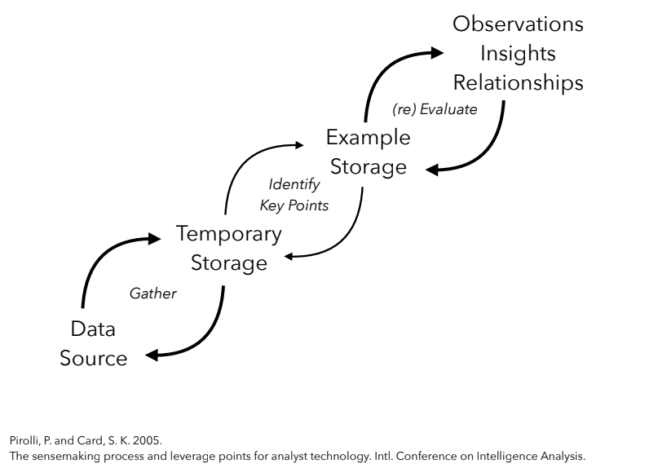

Slide 6
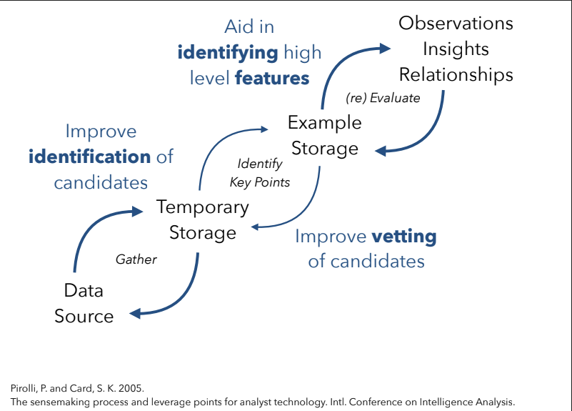

Slide 7
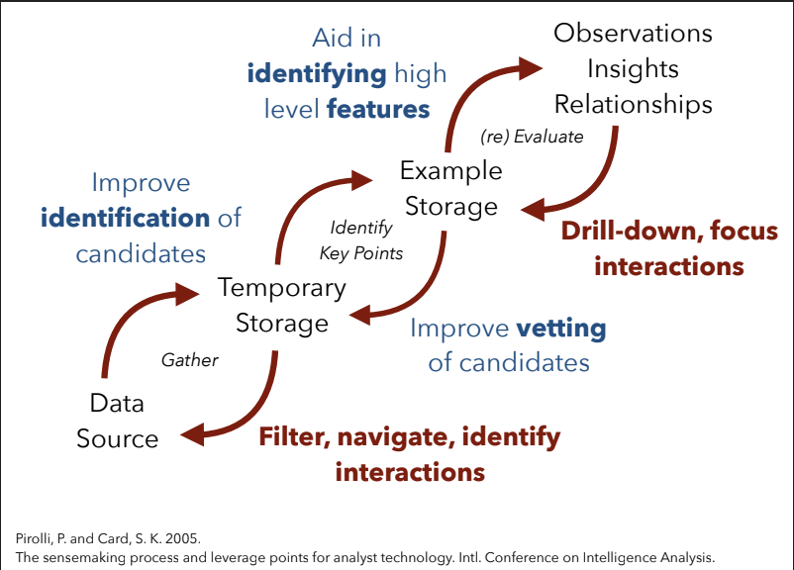

Slide 8
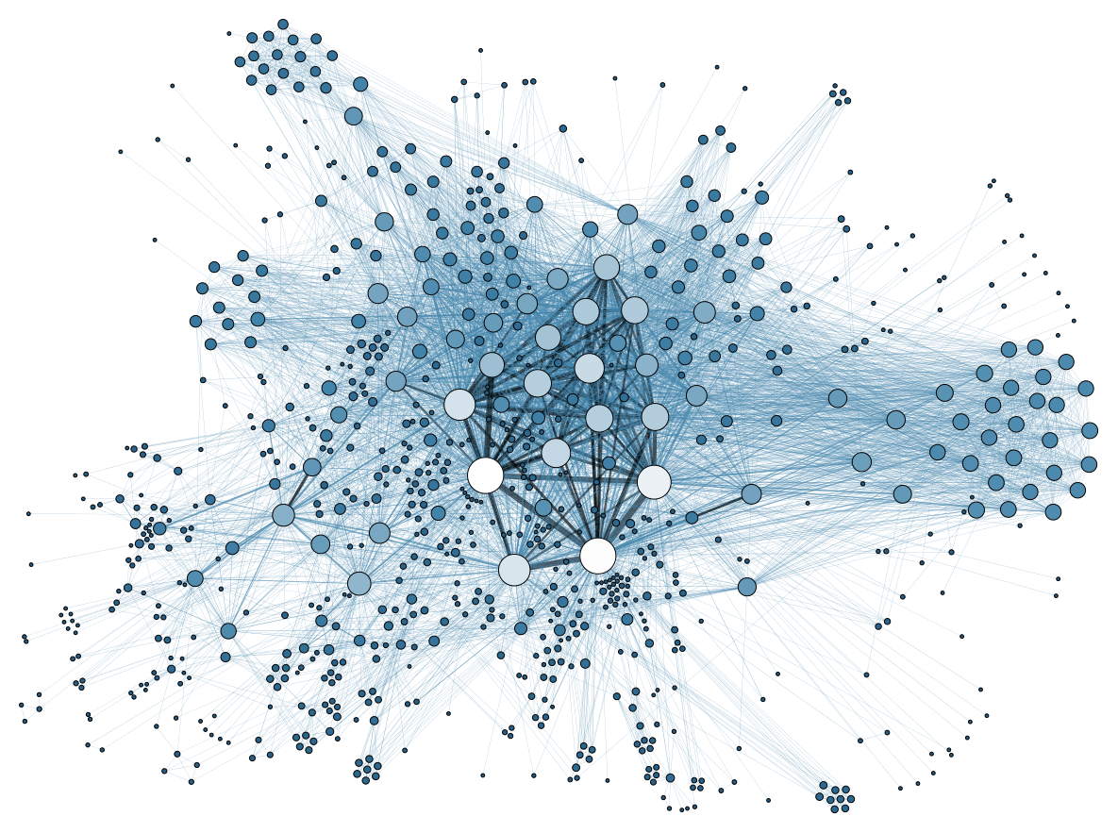
Hairballs

Slide 9
Today’s Agenda
Visualization of information:
Can be used to manipulate; enlighten; explore
Visualization to communicate versus hide uncertainty: why hide uncertainty? Why show it?
When to visualize, when not to visualize?
For whom? User-facing visualizations in AI/ML Systems
Tasks to support [quantified self/charts, qualifying a result: medical decisions, is a graphical thing the best form?]
Different forms of showing data or results to users
For whom? Visualization for development of AI/ML Systems
Tasks to support
Understanding what’s in your data: Fairvis, What-if tool

Slide 10
The process of visualization
Choose Data -> Transform -> map to visual attributes
E.g.
Student grades -> Group grades (+/-10 points) -> map each group to a bar, and number of students in group to height of bar chart

Slide 11
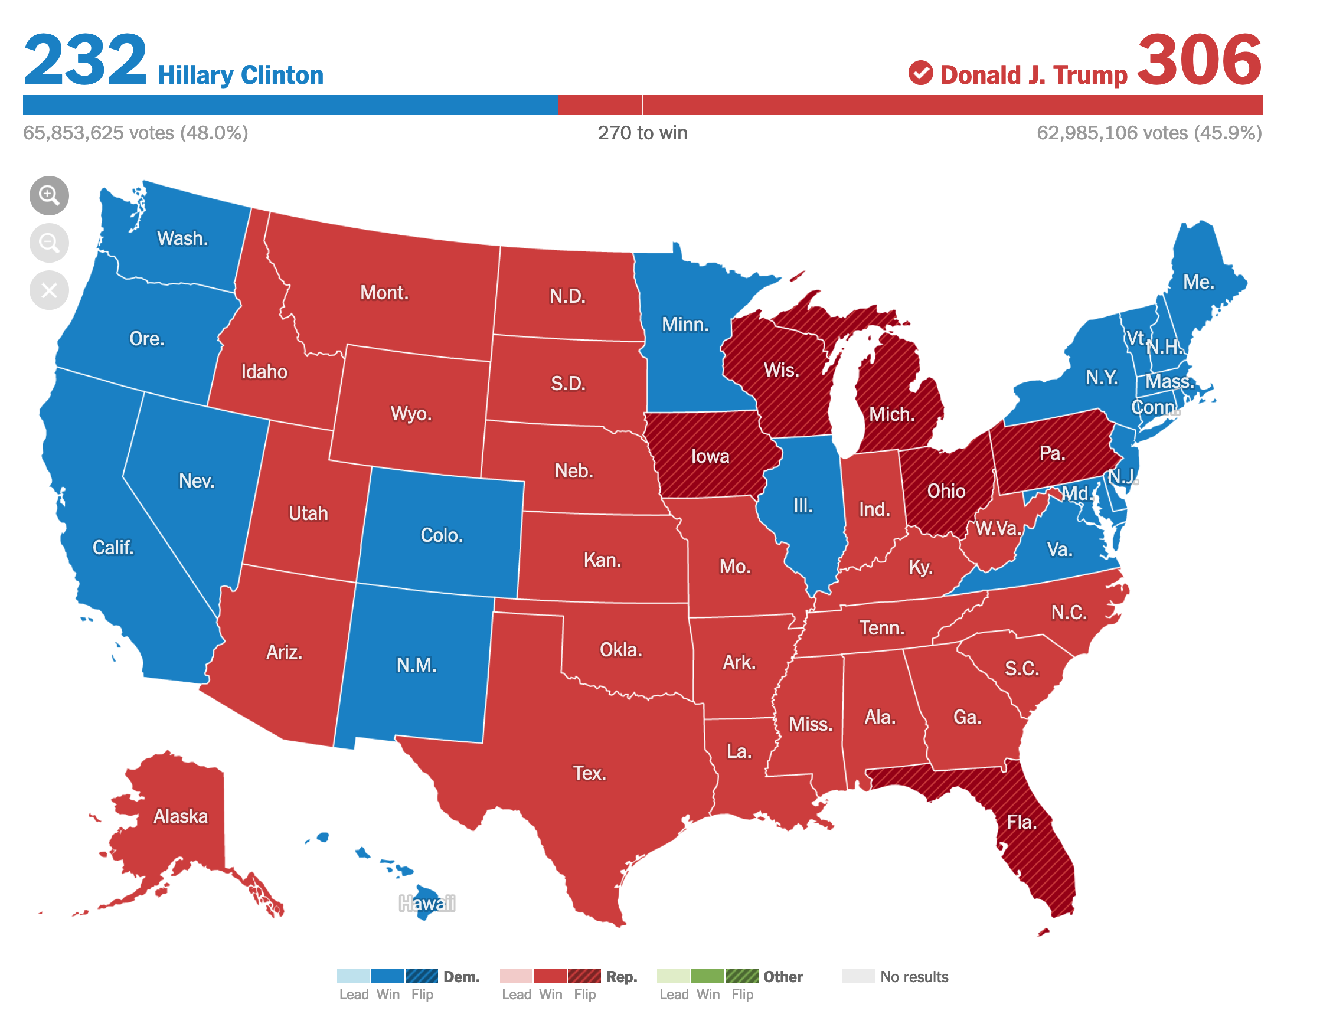
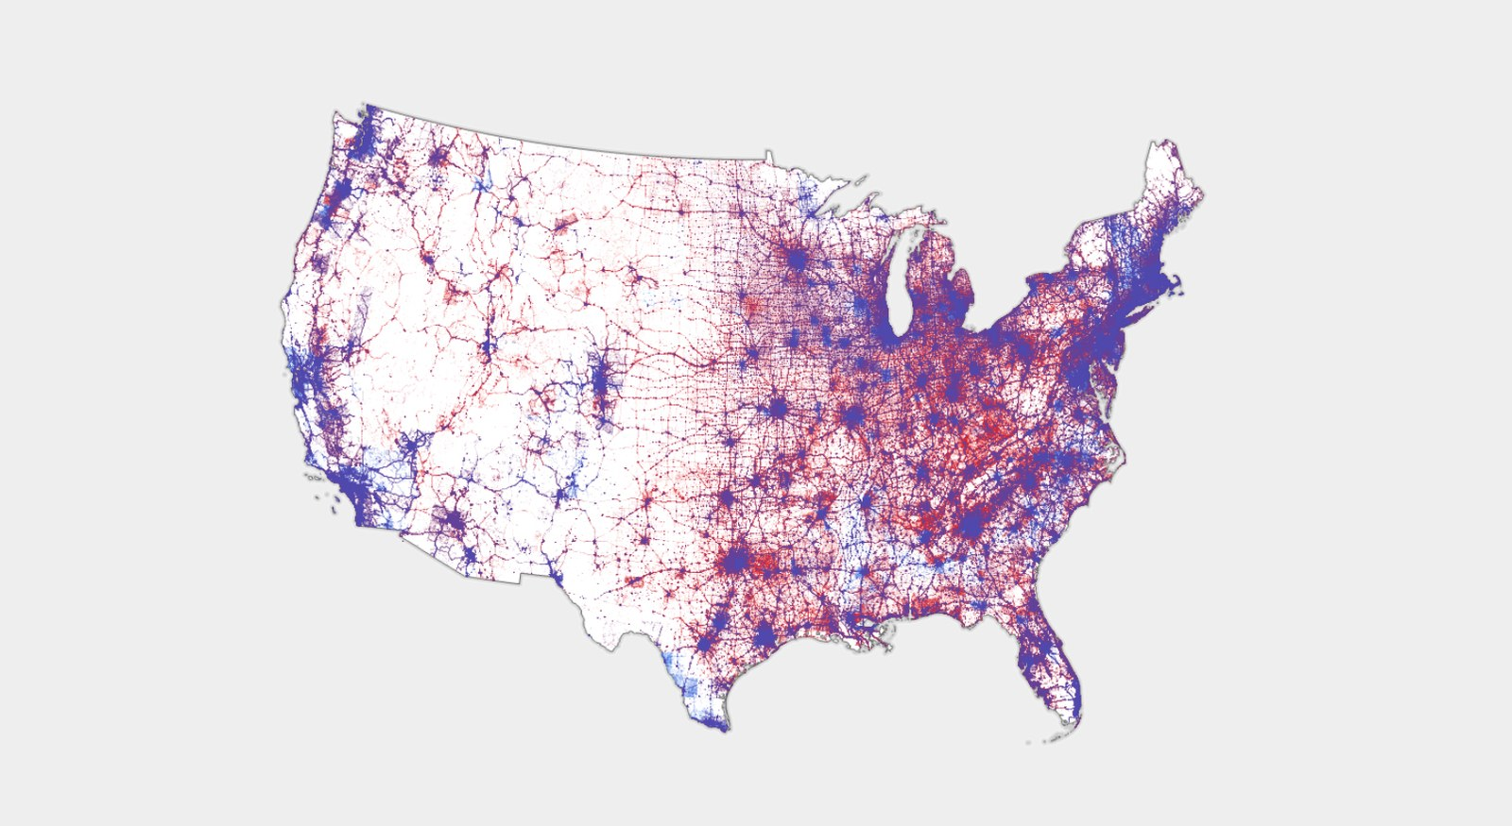
Choosing the right data
Electoral college map
Popular vote map
Notes:
Left https://www.nytimes.com/elections/2016/results/president
Right https://www.wired.com/story/is-us-leaning-red-or-blue-election-maps/

Slide 12
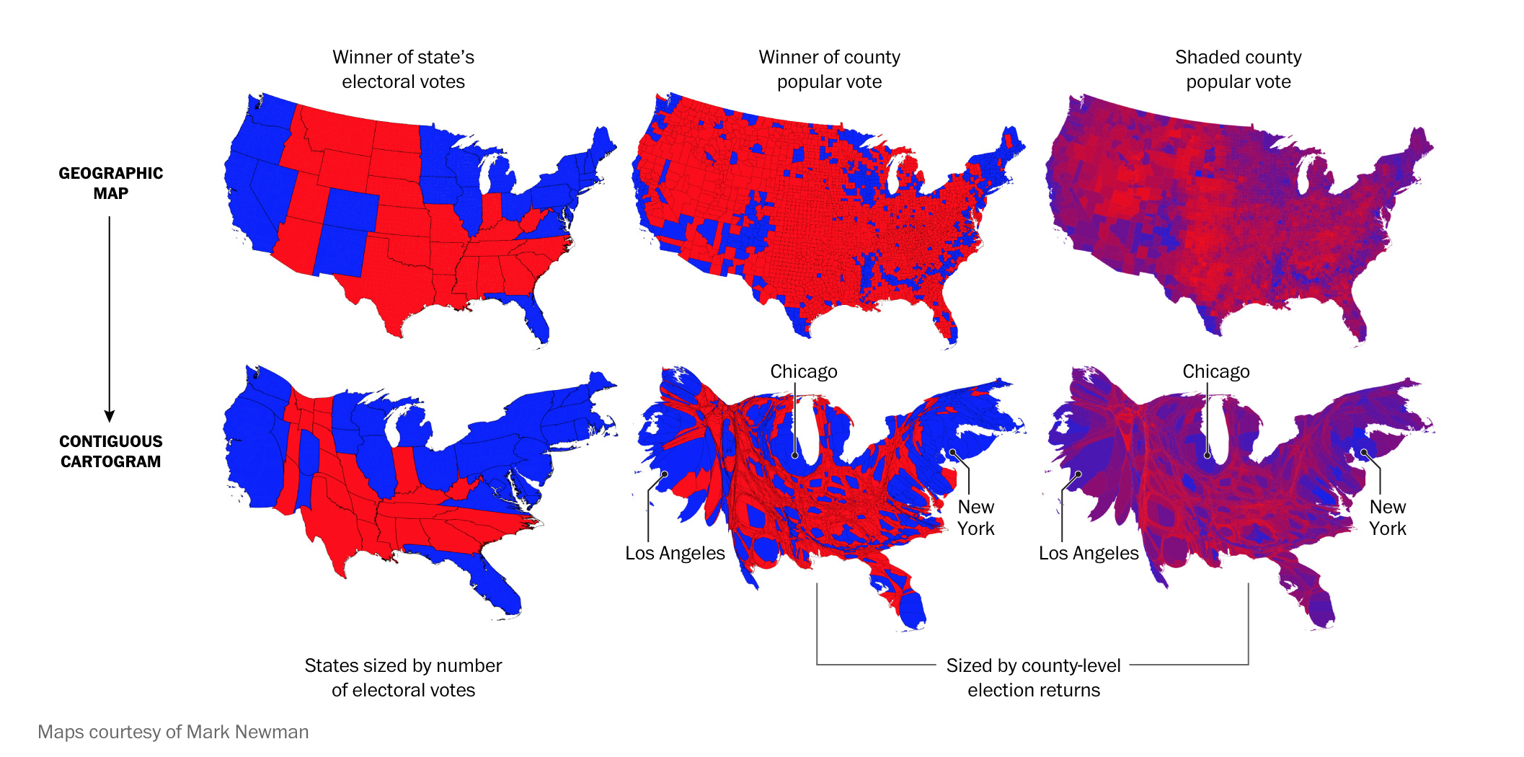
Choosing the right transformation
Notes:
https://www.washingtonpost.com/graphics/politics/2016-election/how-election-maps-lie/

Slide 13
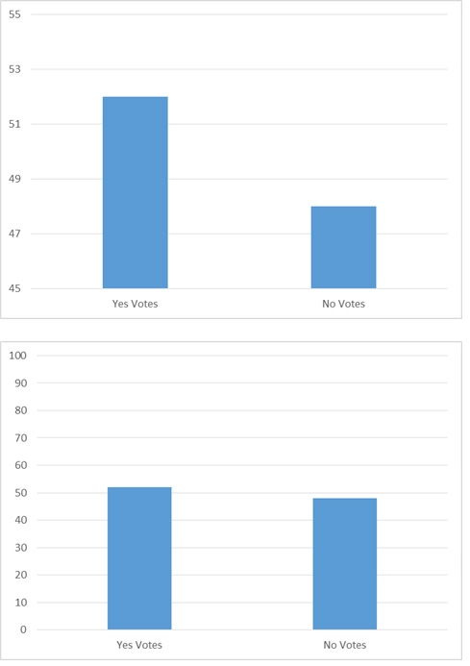
Perils of transforming data poorly
Scales are so easy to abuse
Notes:
https://learningsolutionsmag.com/articles/misleading-data-visualizations-can-confuse-deceive-learners

Slide 14
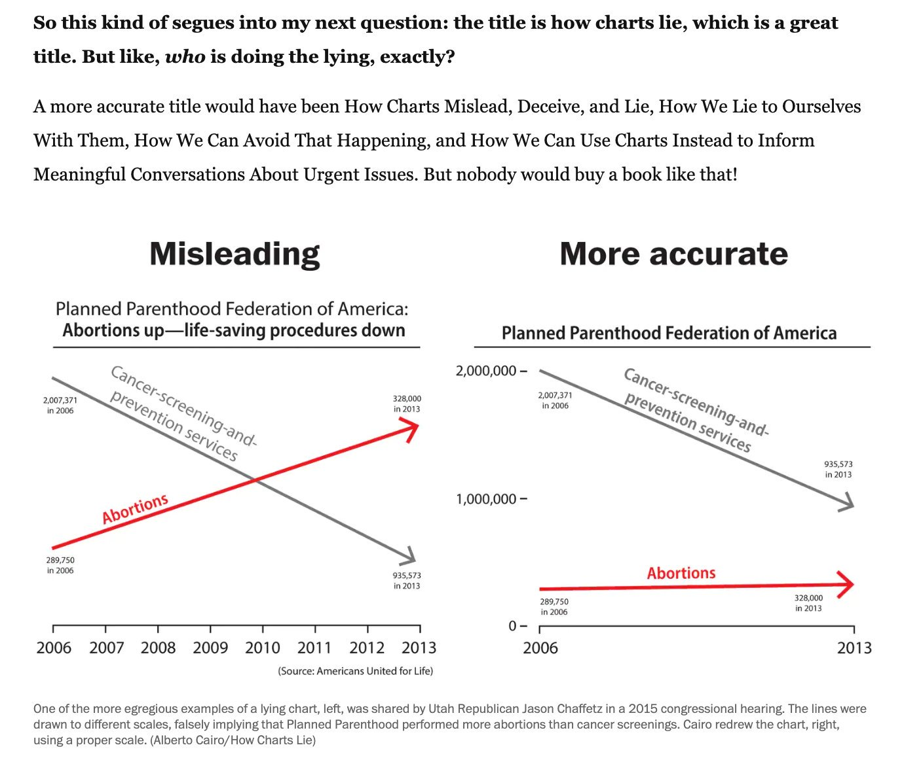
Perils of transforming data poorly
Scales are so easy to abuse
Notes:
https://twitter.com/AlbertoCairo/status/1183727709005983746?s=20

Slide 15
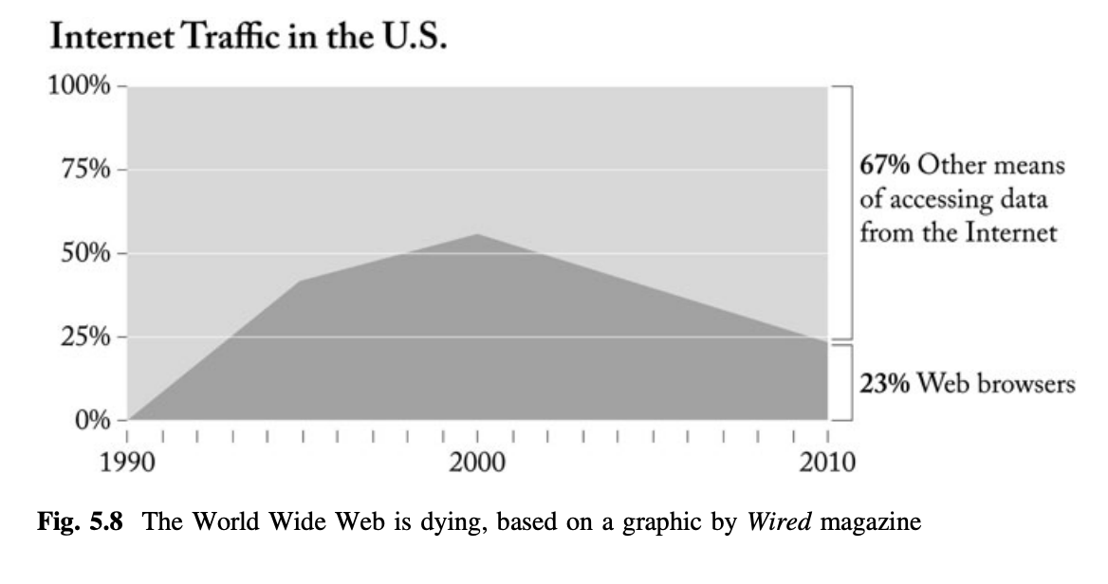
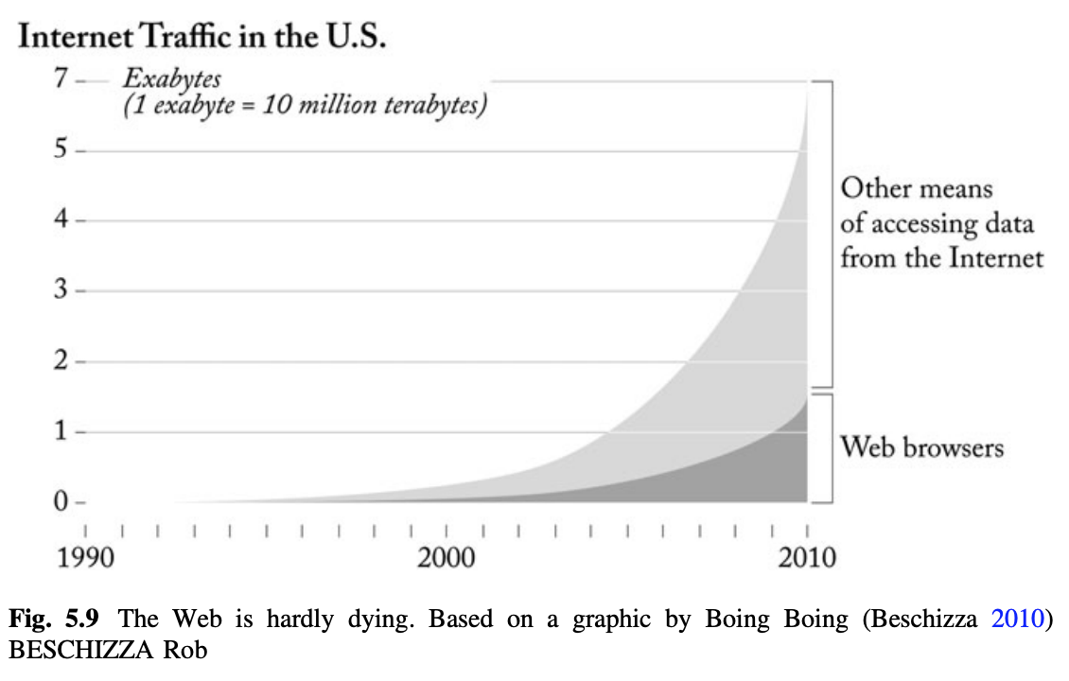
Perils of transforming data poorly
Percentages make sense for proportions only
PS: Did Internet traffic from browsers grow faster 2000-2005 than 2005-2010?
Notes:
Graphics Lies, Misleading Visuals https://infovis.fh-potsdam.de/readings/Cairo2015.pdf
Pie charts https://www.businessinsider.com/pie-charts-are-the-worst-2013-6

Slide 16
Perils of transforming data poorly
Percentages make sense for proportions only
A linear scale for exponentially distributed quantities makes it hard to compare rates
Notes:
Graphics Lies, Misleading Visuals https://infovis.fh-potsdam.de/readings/Cairo2015.pdf
Pie charts https://www.businessinsider.com/pie-charts-are-the-worst-2013-6

Slide 17
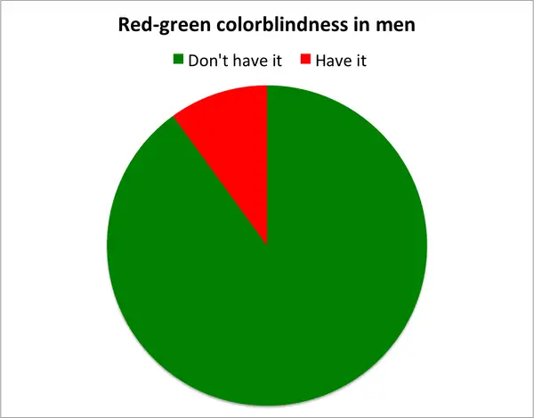
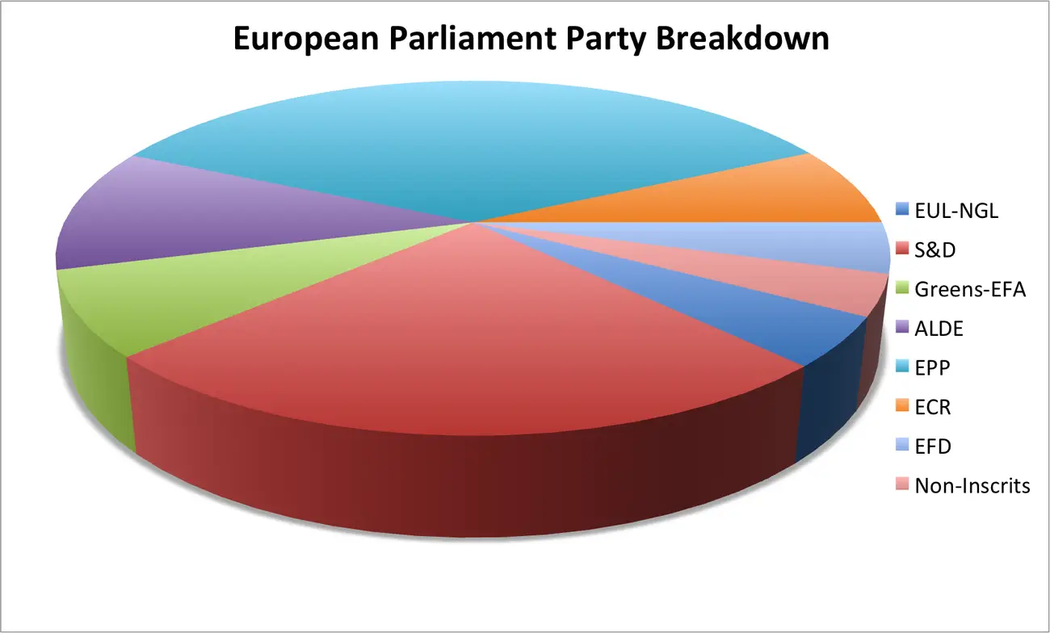
Perils of encoding data poorly
What fraction of men can read the pie chart?
How much larger is “Don’t have it” to “have it”?
Is ALDE > (EPP + Non-inscrits + EUL-NGL)?
Notes:
Graphics Lies, Misleading Visuals https://infovis.fh-potsdam.de/readings/Cairo2015.pdf
Pie charts https://www.businessinsider.com/pie-charts-are-the-worst-2013-6

Slide 18
Perils of encoding data poorly
What fraction of men can read the pie chart?
Reading angles is hard
Reading angles in perspective is harder
How much larger is “Don’t have it” to “have it”?
Comparing angles is harder
Is ALDE > (EPP + Non-inscrits + EUL-NGL)?
Angle math is really hard!
Notes:
Graphics Lies, Misleading Visuals https://infovis.fh-potsdam.de/readings/Cairo2015.pdf
Pie charts https://www.businessinsider.com/pie-charts-are-the-worst-2013-6

Slide 19
Encoding: Which is the bigger square?
Notes:
Left is slightly bigger

Slide 20
Encoding: Which is the bigger square?
Notes:
Right is slightly bigger

Slide 21
Encoding: How much bigger is circle on right?
1.5x?
2x?
3x?

Slide 22
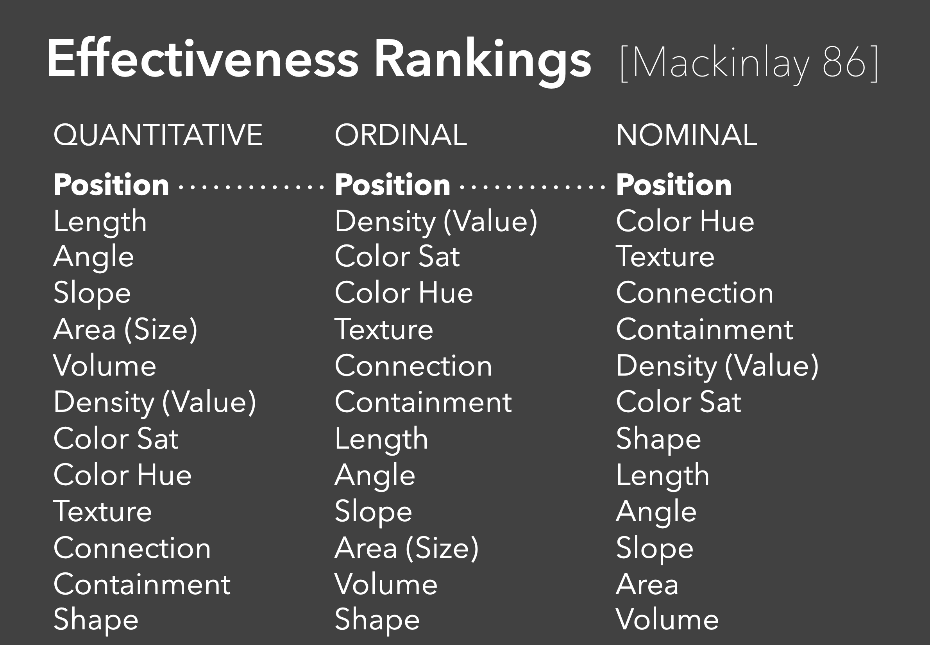
From Jeff Heer: https://courses.cs.washington.edu/courses/cse442/17au/lectures/CSE442-VisualEncoding.pdf

Slide 23
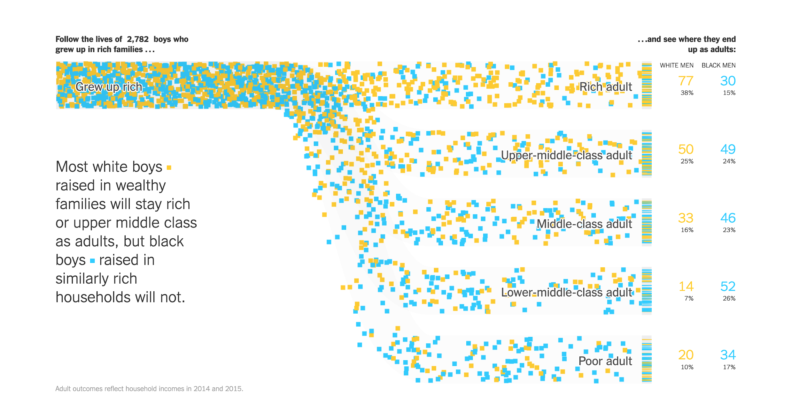
Notes:
https://www.nytimes.com/interactive/2018/03/19/upshot/race-class-white-and-black-men.html

Slide 24
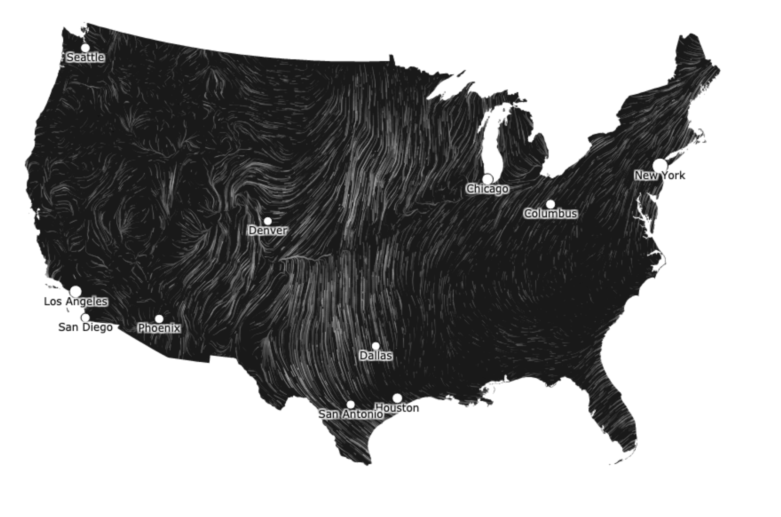

Slide 25
Why is visualization different for AI-infused products?
Data is often output of algorithms -- so it is uncertain
Inputs are also sometimes uncertain

Slide 26
Visualizing for the user of an AI/ML system

Slide 27
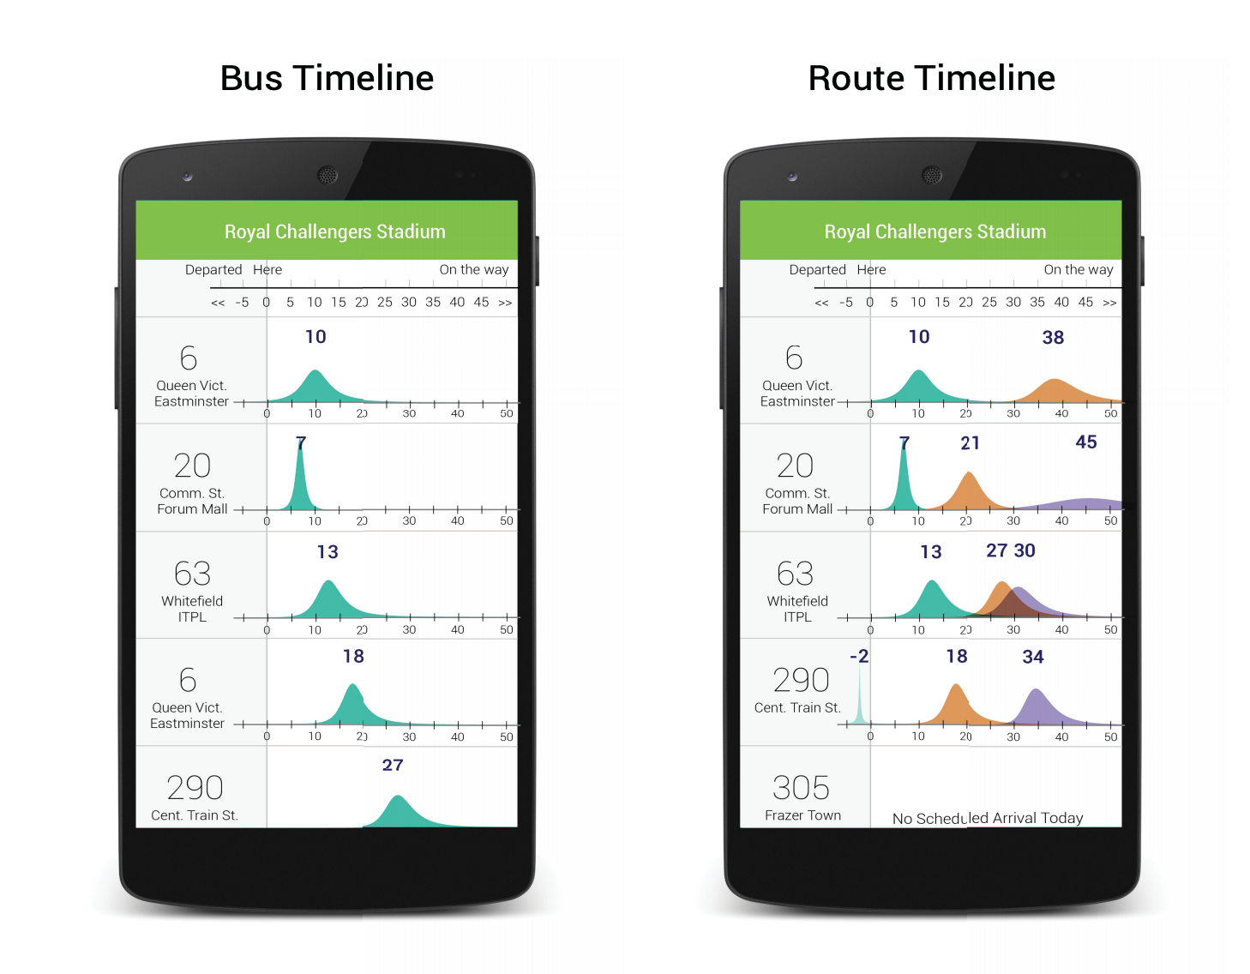
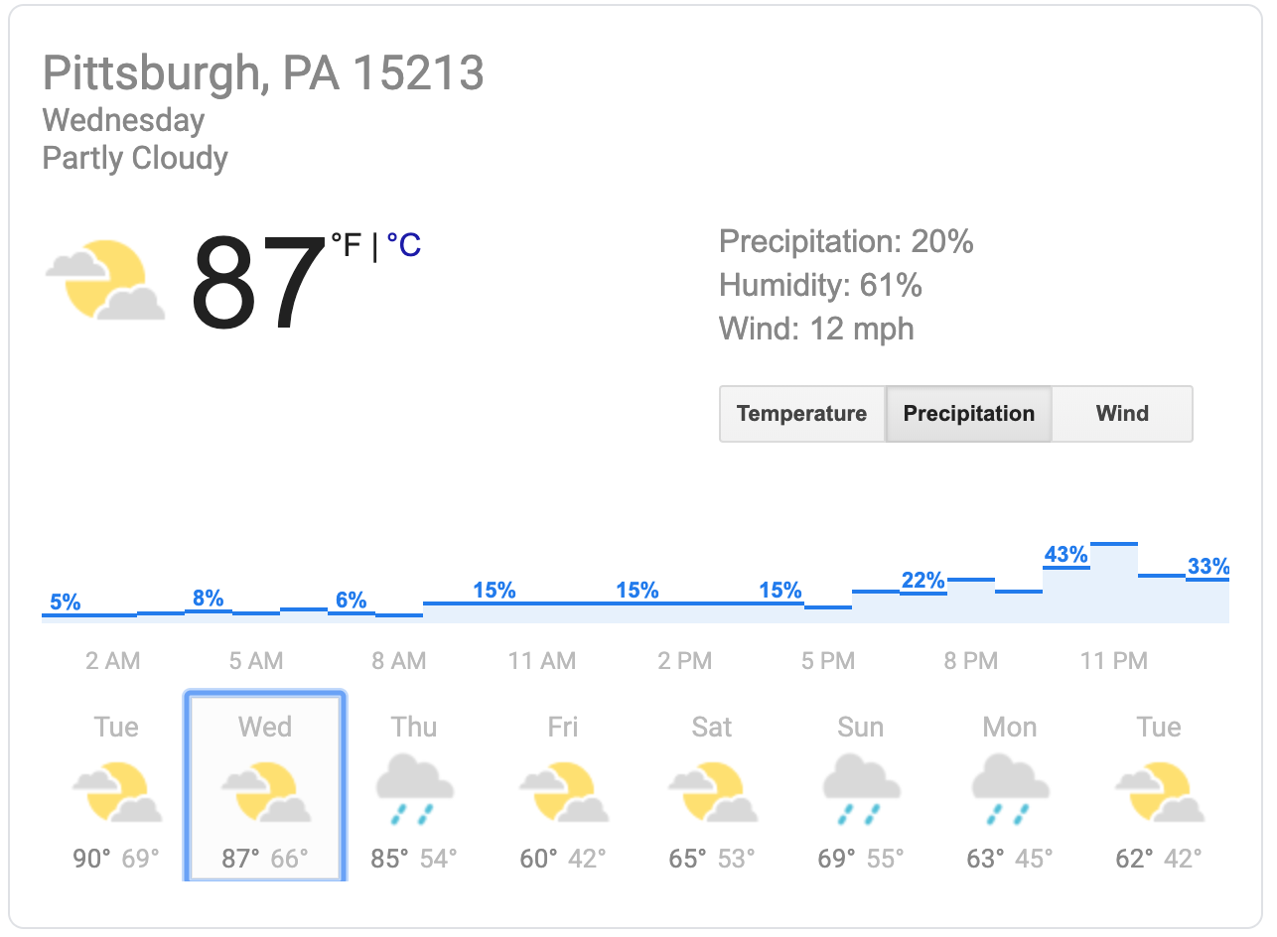
Visualizing uncertainty for users

Slide 28
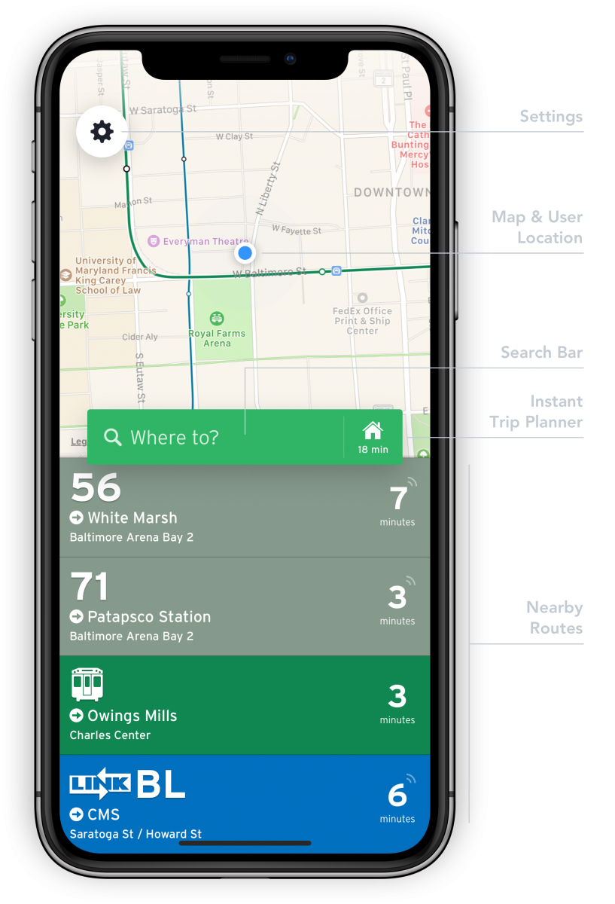
What does visualization give users? Is it worth it?
Notes:
Transit app from MD.gov
Bus visualization from “Where is my bus?”

Slide 29
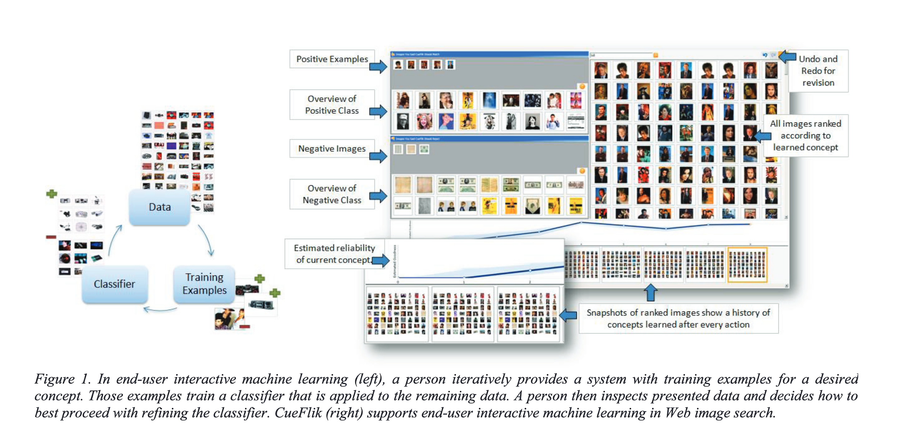
Notes:
https://www.aaai.org/ocs/index.php/AAAI/AAAI11/paper/view/3736/4111

Slide 30
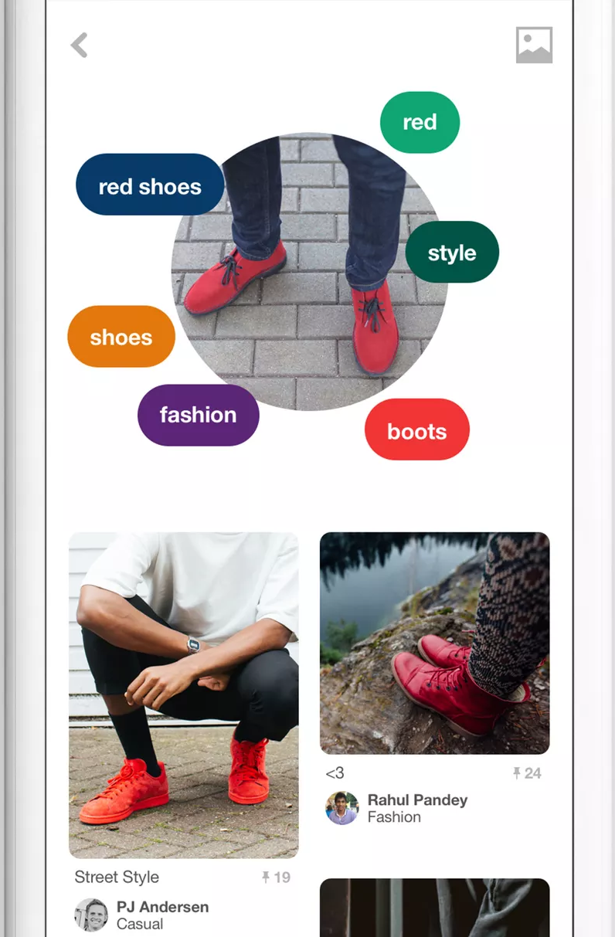
Visualizing similar objects AI/ML
Where is the visualization in this app?
What does visualization give users here?
Notes:
Image sources: https://www.theverge.com/2017/2/8/14549798/pinterest-lens-visual-discovery-shazam

Slide 31
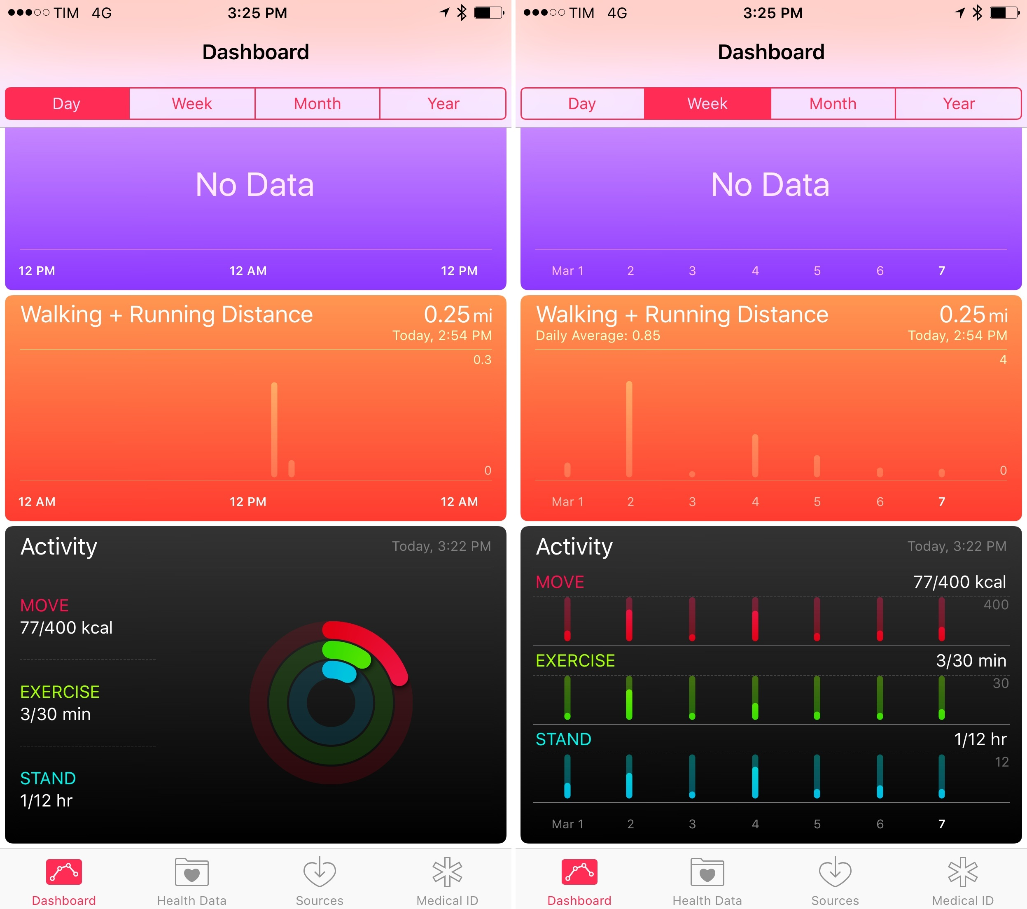
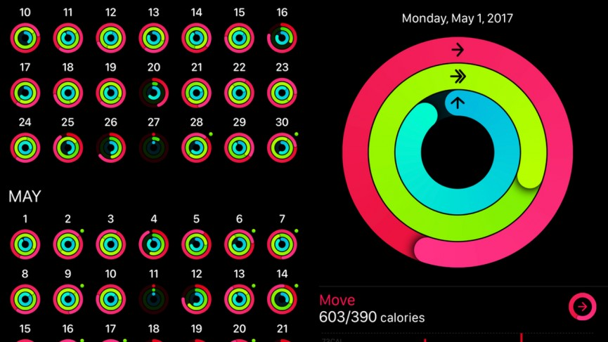
Visualization is good: Quantified self
Shown: Apple health visualization
What do you think of these plots? What is unusual about them?

Slide 32
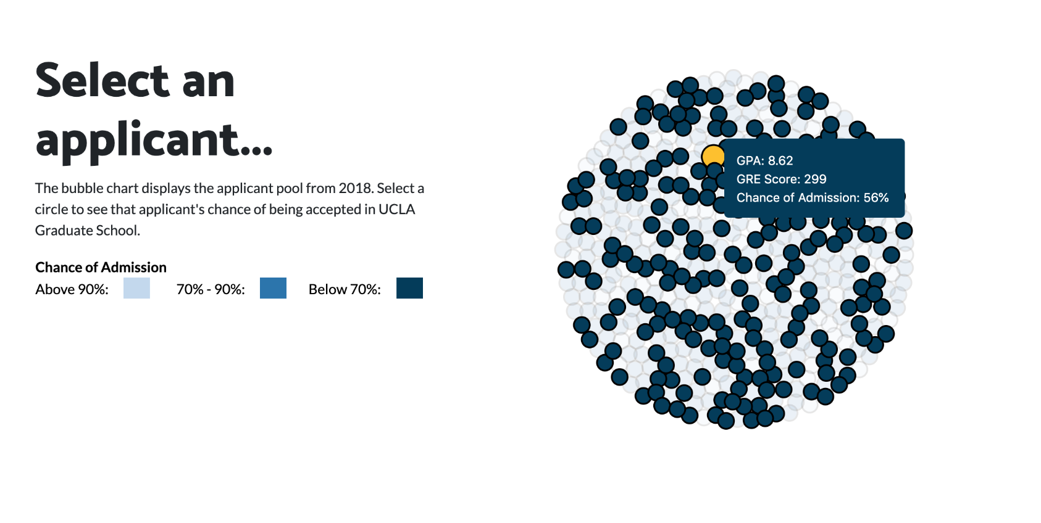
What does visualization give users? Is it worth it?
https://washuvis.github.io/admissions/process-book/
Notes:
Student project https://washuvis.github.io/admissions/process-book/

Slide 33
Visualization for developing AI/ML systems

Slide 34
Tasks for visualization in AI/ML Development
Understanding data that goes into models
Understanding what a dataset contains
Visualize for data cleaning
Visualize for feature creation
Monitoring models
Visualize performance on different data groups
Understand model output
Visually search for possible negative bias or discrimination

Slide 35
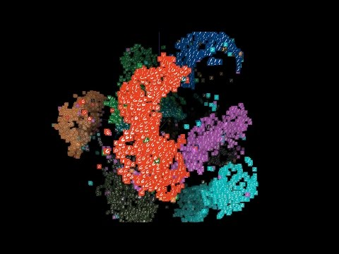
What is in this dataset (at scale)?
What do you think of this hairball?

Slide 36
Exploring desirable outcomes of a model
https://research.google.com/bigpicture/attacking-discrimination-in-ml/
What-if tool
What do you think of these visualizations?
Where you able to gain insights from them, why or why not?
Notes:
https://research.google.com/bigpicture/attacking-discrimination-in-ml/

Slide 37
Reading comments

Slide 38
“However, after reading this article I almost think usability has to be higher for applications that have real life impacts, like in the medical field, because there is very little room for error”

Slide 39
Beyond this, there's still the issues of what the sliders will be among the thousands of features encoded by the model.

Slide 40
Did I overthink the problem or did the algorithm went wrong? In my own mental model, I always think towards the way that let the algorithm build better models and produce better performance. But in the case of medical decisions, it is certainly not the appropriate way.

Slide 41
“I thought the discussion at the end about the precision vs. glanceability tradeoff was really similar to how the class was divided on Tuesday about which type of user interface they would want to see”

